Slide 1
Presentation Foundation of Web Development
Group E
Fall 2022
Members:
Shubhparteek Singh
Lingjun Wan
Ruiqing Zhu

Slide 2
Project: JAC Food Bank
User story: As a user, I would like to be able to place the order online and have the option to either pick up the order or have it delivered to me.
Solution: Create a website with online shopping capabilities for John Abbott College Food Bank.

Slide 3
Requirement
Create the website using HTML, CSS, and JavaScript.
Have a home page with introduction to the web site and service.
Have a registration page with validation of user entered data.
Have a sign in page with validation of user's input.
Once signed in, users should be presented with an option to shop online.
Users should be able to place orders by putting items into the shopping cart and submitting the request.
Have a Contact us page with form validation.
Have a News and Events page.

Slide 4
Design
Homepage: Main landing page with menus linked to different sections of the website.
Add social media links to every page using footer in our design layout.
Different CSS selectors will be used to finalize the look and feel of the project.
Registration page: Validate the following:
— username, first name, last name, email address, and password.
Sign-in page: Validate exact match of username and password and do non-empty check.

Slide 5
Design
Shop page: List items with an input box to enter quantity and have a “Place Order” button.
Once the user clicks the "Add to cart" button, the item is added to the cart, and a check is placed to avoid adding the same item twice.
Contact Us page: Create a form for users to enter their information and submit. Implement non-empty check.
News and Events: Make some collapsible items. Detailed text will show when expanded.
Special attention: Make sure everything is linked to the proper page. When a user is logged in, it should not log the user out unless the user clicks the Sign out button.

Slide 6
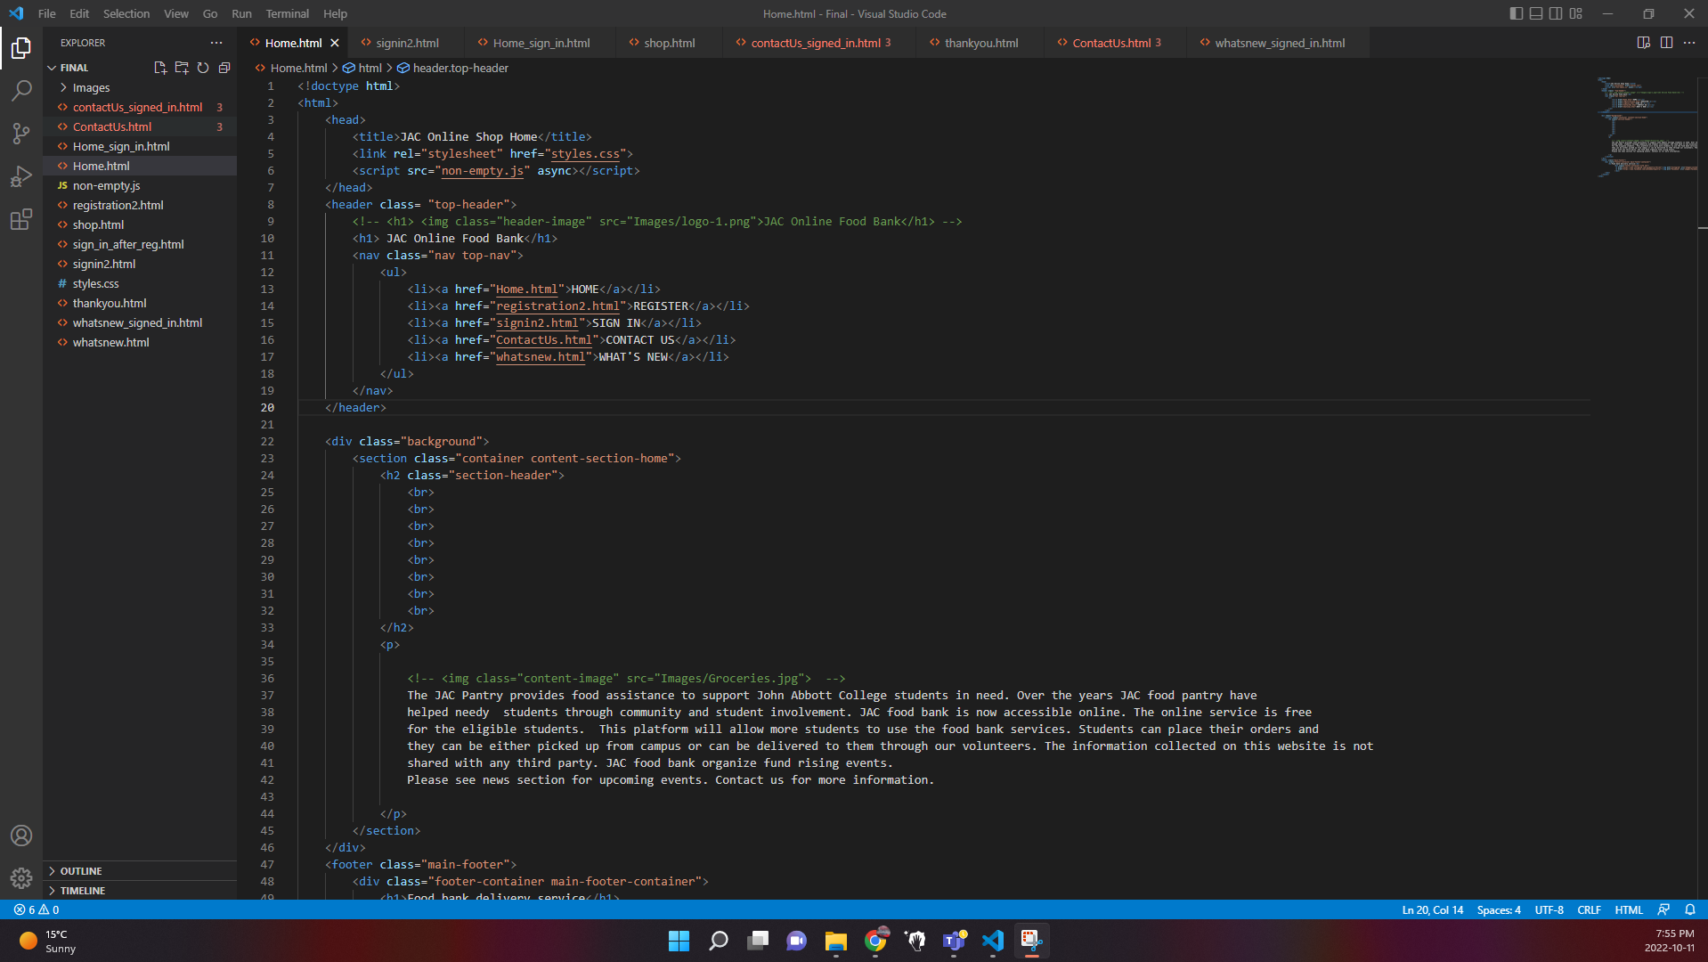
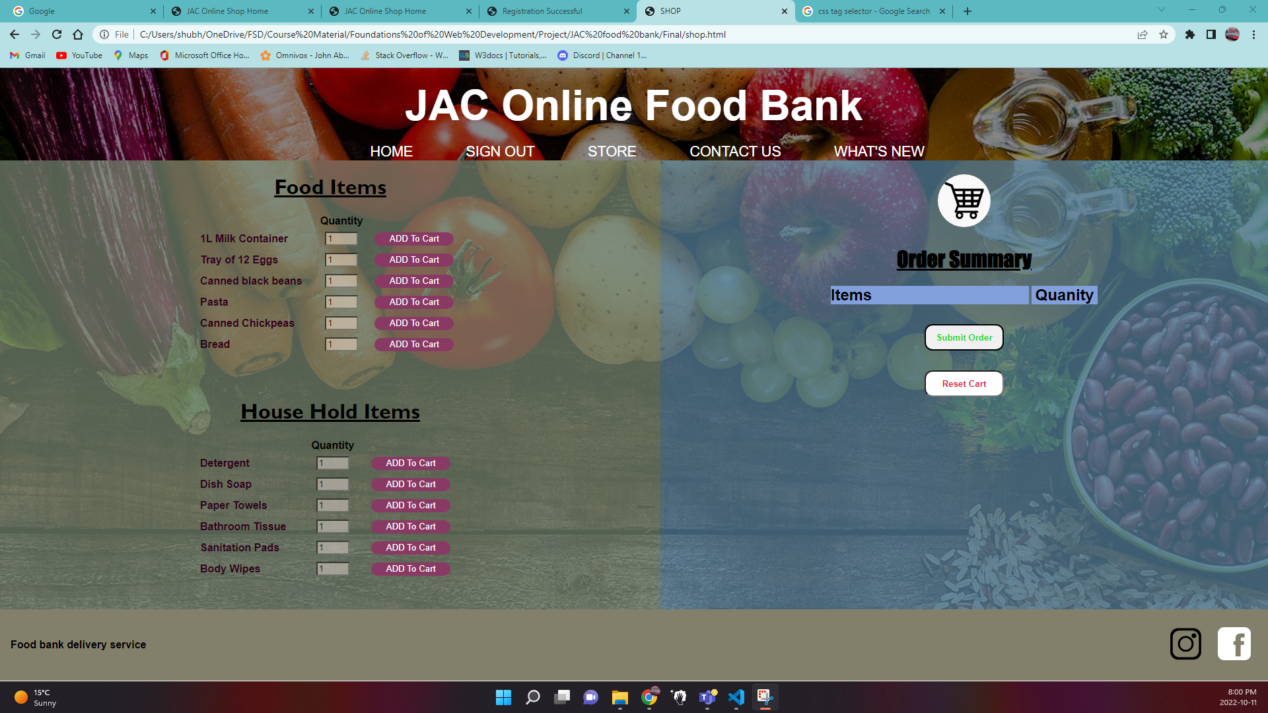
Sneak Peak

Slide 7
Future Scope
Due to the time constraint, some of the design idea couldn’t be implemented at this time but will be considered as the iteration goes:
Shopping cart could be more responsive (auto update quantities, etc.).
Forms could be implemented to save and check user login information as currently all the information/data is processed hard-coded.

Slide 8
Team member contribution
Shubhparteek Singh – Leading the project, General architecture, Homepage, Shop page, Thank you page
Lingjun Wan – Design idea and user story, Sign in page, Contact us page
Ruiqing Zhu – Registration page, What's new page, PowerPoint Usability test

Slide 9
Demo
JAC Food Bank

